Slide 1





Sogrape & 42porto Hackathon
Online price harvesting
aamaral-, ismirand, jmarinho, numartin, ocaio-re, pabernar

Slide 2











tt
ARCHITECTURE DESIGN
WebScraping
Database
DashBoard
REACT
BeautifulSoup
Main

Slide 3
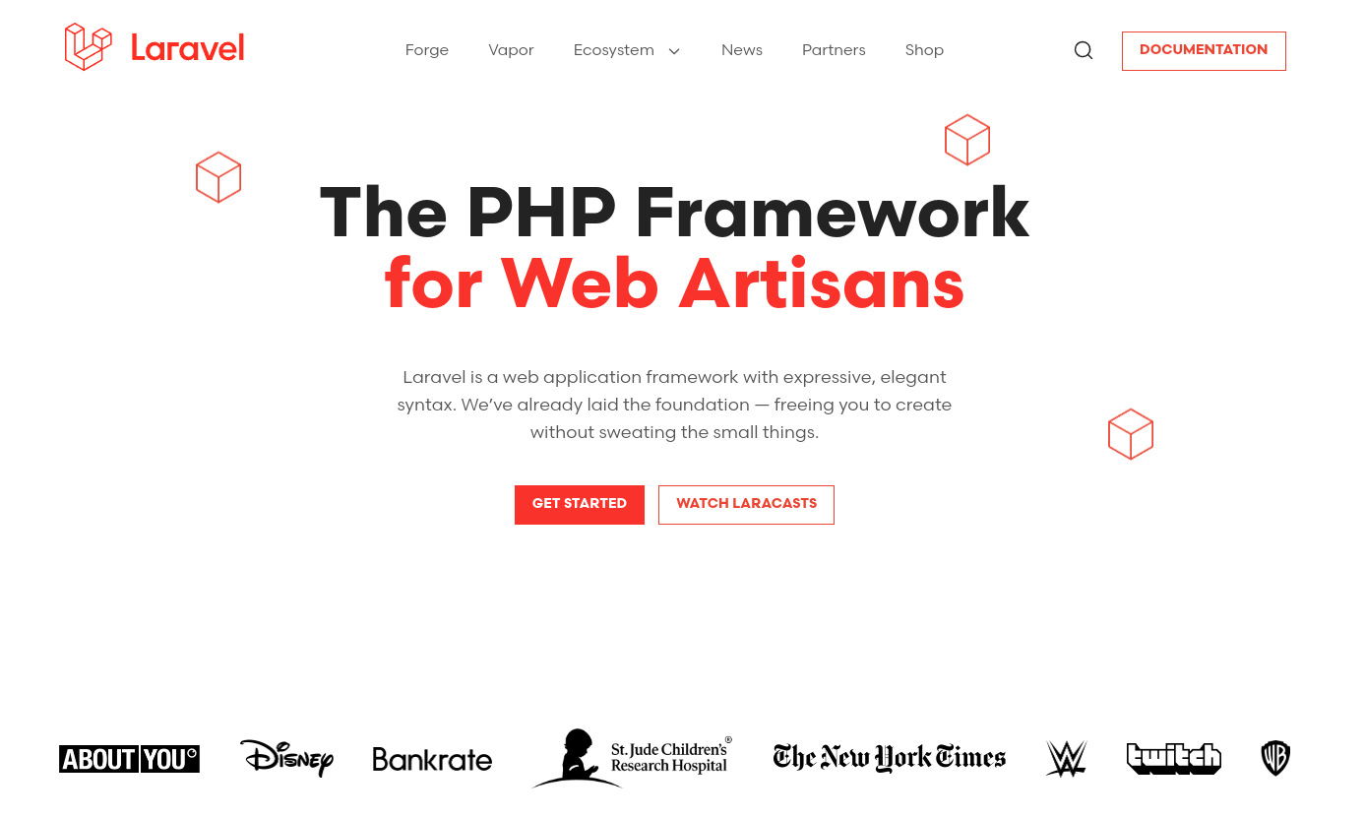

Slide 4





CHALLENGES
Redirects the Web scraper to a script page
Clean the information and find the product page
Protection against scraping
Fakes an usual browser

Slide 5
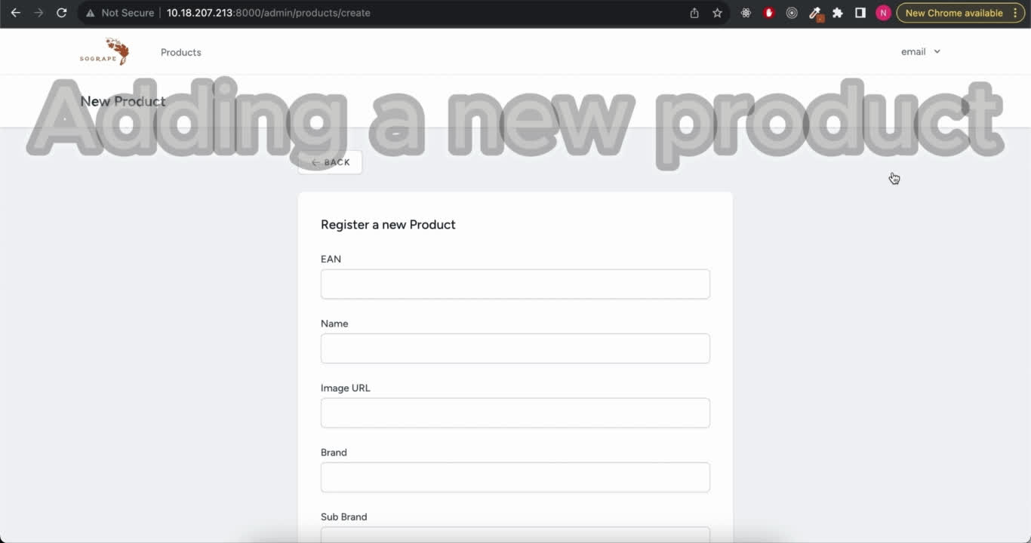

Slide 6
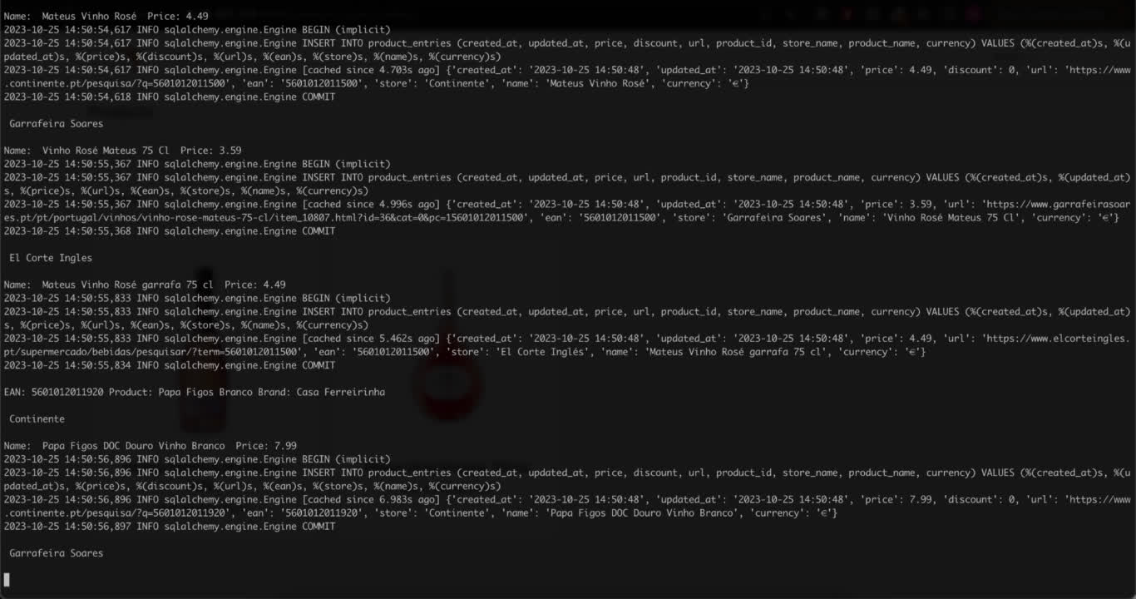

Slide 7
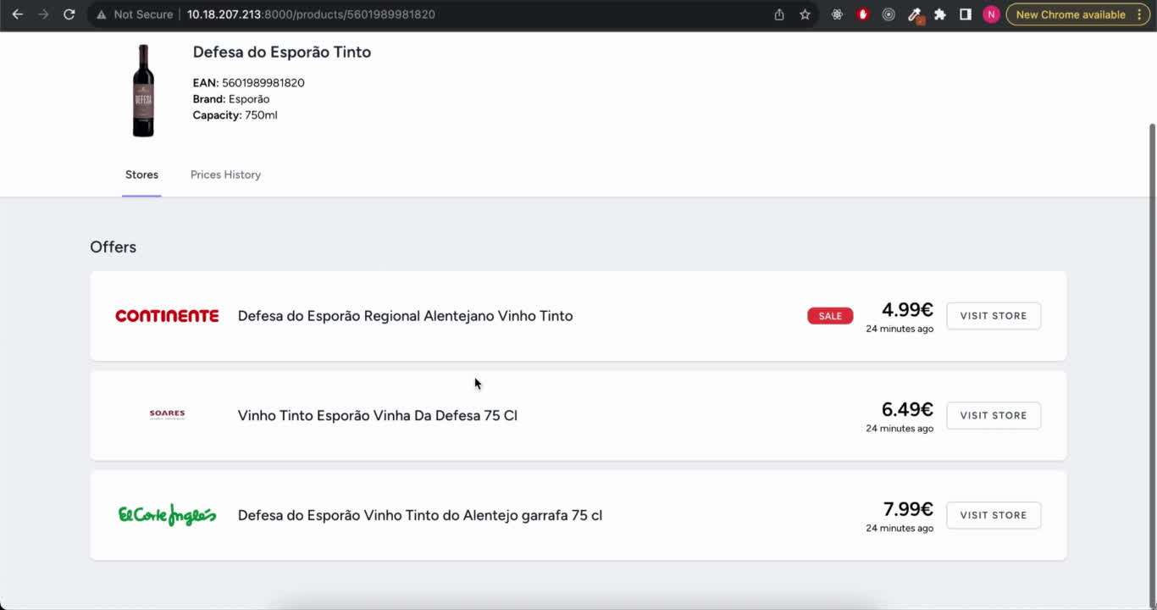

Slide 8
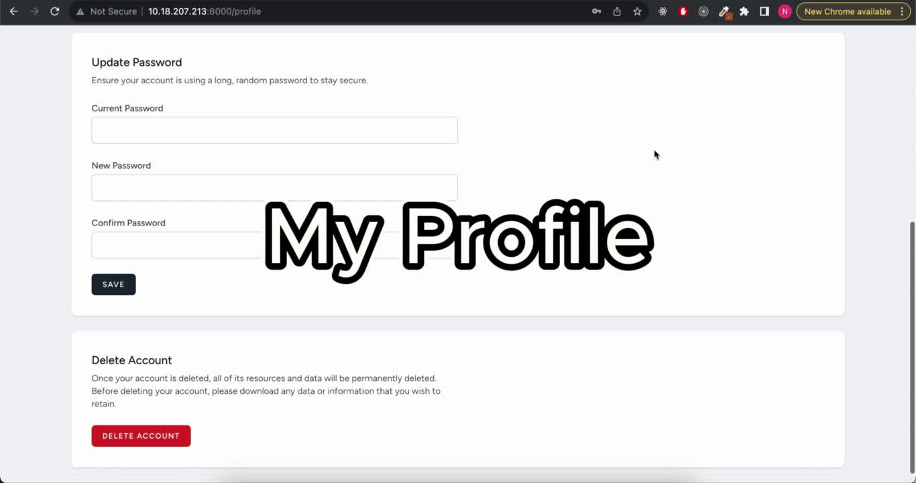

Slide 9









NEXT STEPS
Personalized profiles: Permissions
Price changing alerts
Improve dashboard filters:
countries and zip codes
Enhance graphics coverage
Scrape and display information about competitors
Documentation for implementation and maintenance

Slide 10
Considerations
COUPLED
DECOUPLED
Monolithic
Two servers:
One server
Laravel API
REACT, VUE, Nextjs...
Single codebase
Dedicated teams
Frontend and Backend
Feed more apps
Better for small teams
Mobile apps, smartwatches, other apps or services

Slide 11
RECOMENDATIONS
Docker
CI/CD
Testing
Typescript
Multiple scrapers dedicated to specific zones
Dashboard for different timezones and location

Slide 12
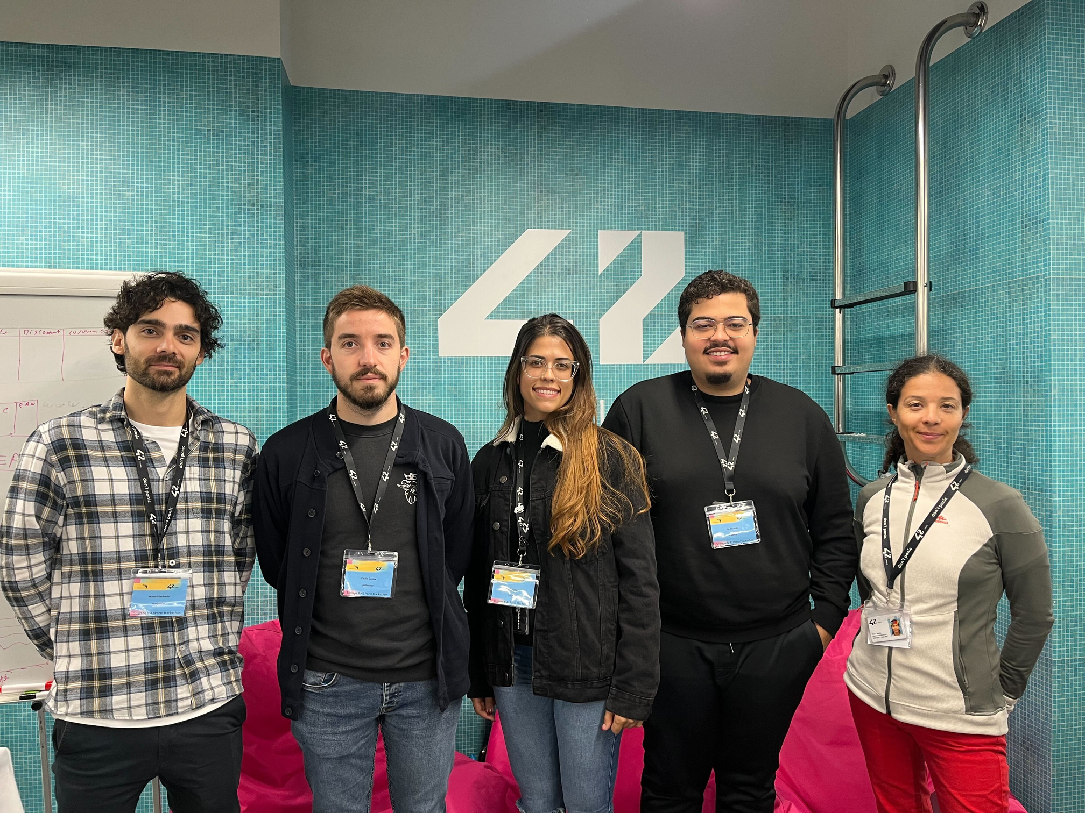
THANK YOU! :P

